Slide 1
TUATRO
Group A
Recommendation Engines Final Project

Slide 2
Context
Before watching a film:
Trailer(s), advertisement
Well-known actors, actresses, directors…even “indie” one and foreigners
”I watch all movies of...”
Technical analysis (Youtube)
Reviews: IMDB, magazines, Twitter...Professional and amateur
Friends’ opinion (main leisure activity)

Slide 3

Context
The 3 trailers were cool, the main actor is one of my favourites, in Twitter, Facebook...it always appear some good comments about this film, my close friends told me they like it...SURELY I WOULD LIKE THIS FILM, and I cannot wait to see it at home. I am going to the cinema.

Slide 4
Context
Before going to the theater:
No trailers, no advertisement
No well-known actor, actresses, directors…
”I know Lion King Musical and Billy Elliot”
Only very specialized platforms tended to echo theater’s news.
Range of prices: $$ - $$$. On average: more expensive than cinema
Shorter run time
🡇 Friends’ opinion (maybe one friend…)

Slide 5
Context
My friend Juan David told me to see “Las Canciones” from Pablo Messiez; I went and I LOVED THE EXPERIENCED. The live...I want to come back to the theater, I am sure that there are plays which fits me like my favourite films, but...which play should I see? I DO NOT WANT TO SPEND MONEY BLINDLY...

Slide 6

Context
Before going to the theater:

Slide 7
Context
TUATRO
🢛
Before going to the theater:

Slide 8
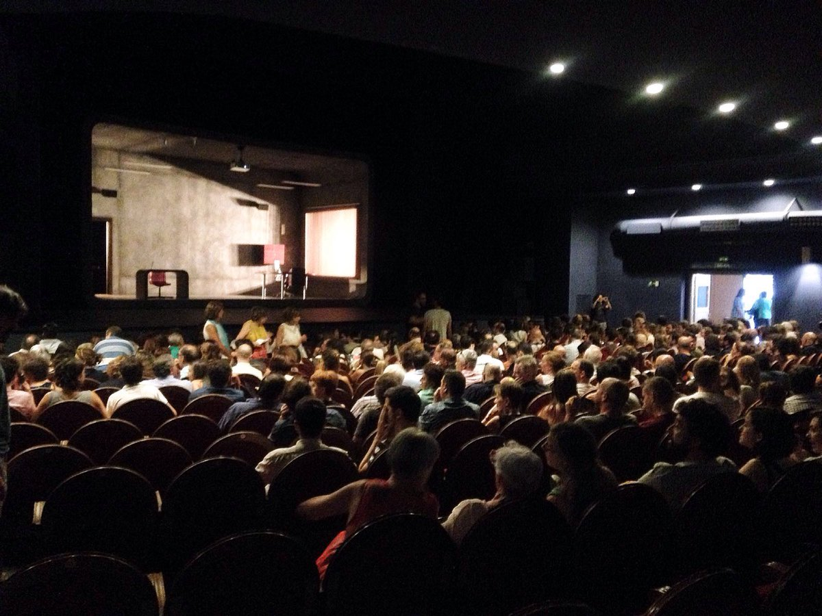
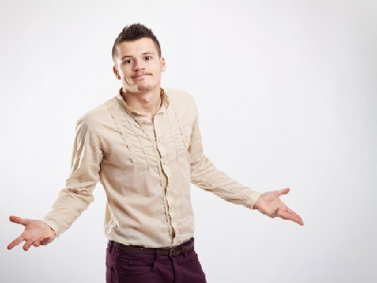
Problem
People willing to repeat a great theater experience or have a very good first one, without going blindly
Non stop offers with interesting stories, creative ideas (but with short run time)

Slide 9

Problem
People willing to repeat a great theater experience or have a very good first one, without going blindly
Non stop offers with interesting stories, creative ideas (but with short run time)

Slide 10
Problem
People willing to repeat a great theater experience or have a very good first one, without going blindly
Non stop offers with interesting stories, creative ideas (but with short run time)

Slide 11
Customers
Theaters:
Personal recommendations to encourage people ➨ + Clients ➨ + Money
People interested in entering into the theater’s world:
41.7% does not go due to lack of interest and misinformation
19.4% said that the shortage of economic resources away them from theaters
Universidad de Oviedo. (2018). El consumo cultural: ¿cuestión de gusto o de precio?. Instituto Nacional de Estadística. (2015). Encuesta de Condiciones de Vida.

Slide 12
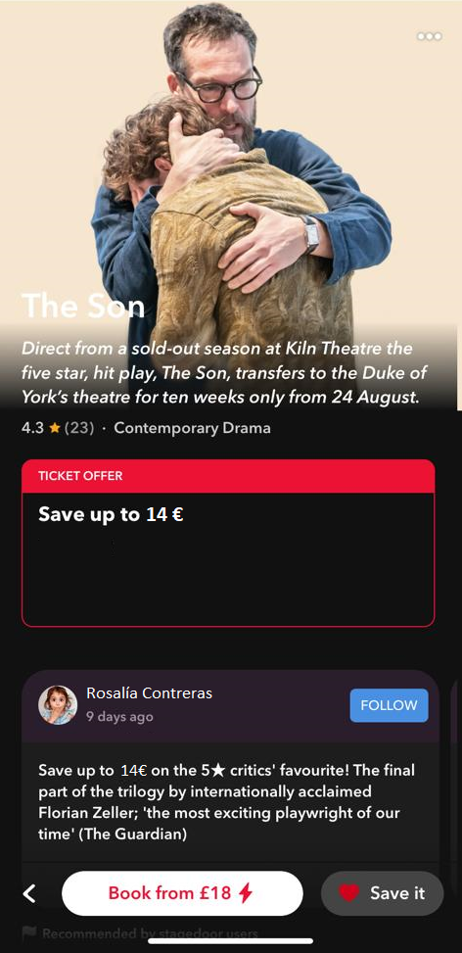
Business Model
How we make money? ➨ Linking TUATRO App with Tickets Sales
From TUATRO, you can directly buy tickets for your theater’s play/musical
3% of ticket price is for TUATRO
-Ticket price remains the same ➨ We take the 3% from theater, not final client.

Slide 13

Business Control and Analytics
With our Business Model strategy to make money, we can analyze how many tickets out of the total are being sold thanks to TUATRO ➨ KPI
-Analyze our impact within the different types of plays, different theaters, etc.
-Negotiate better contracts

Slide 14

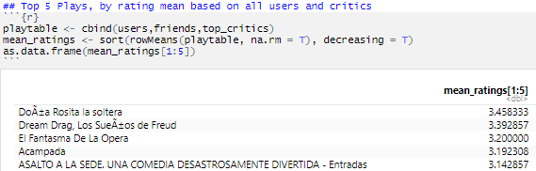


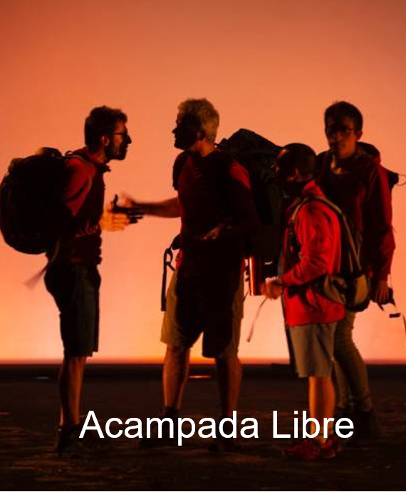
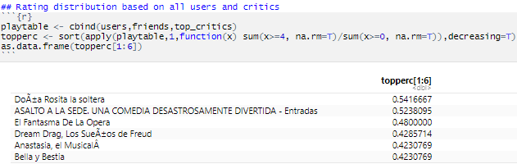



Cold Start
Rating mean:
Based on user reviews:
Based on critic reviews:

Slide 15

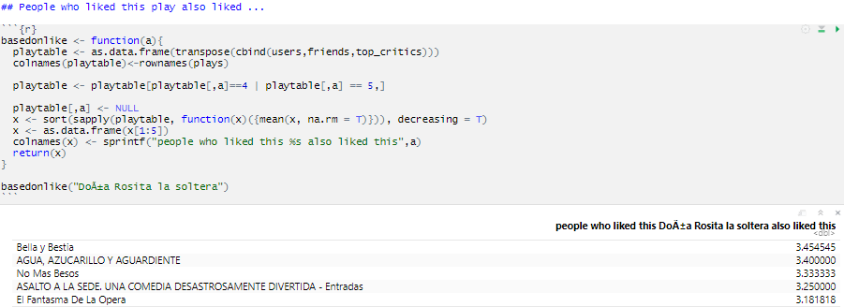


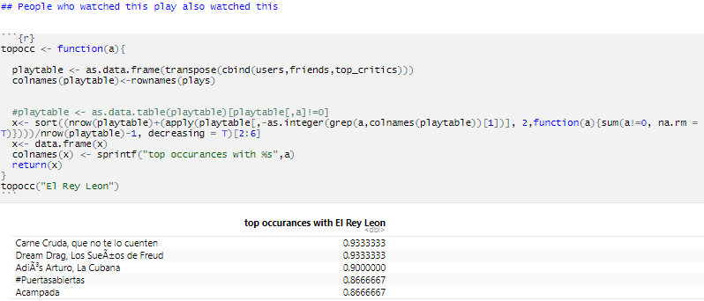

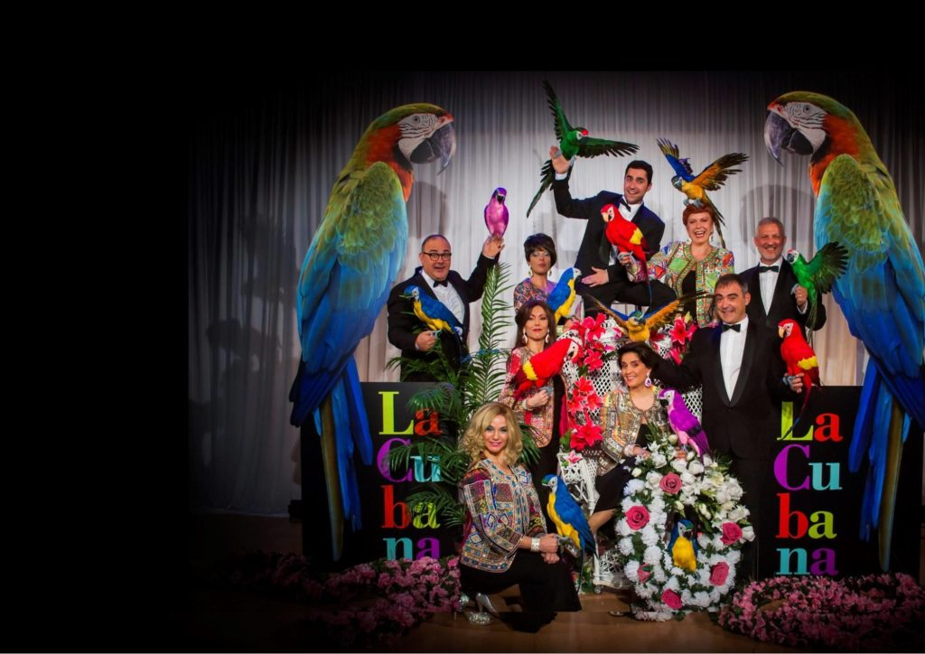
User Interaction
People who liked Doña Rosita also liked:
People who watched El Rey Leon also watched:

Slide 16

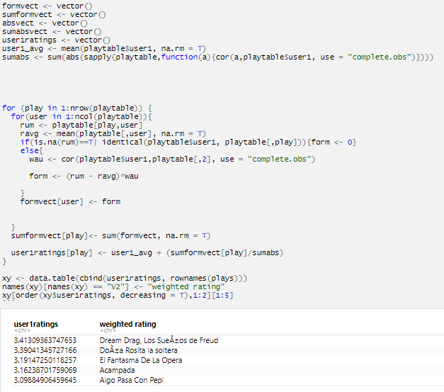

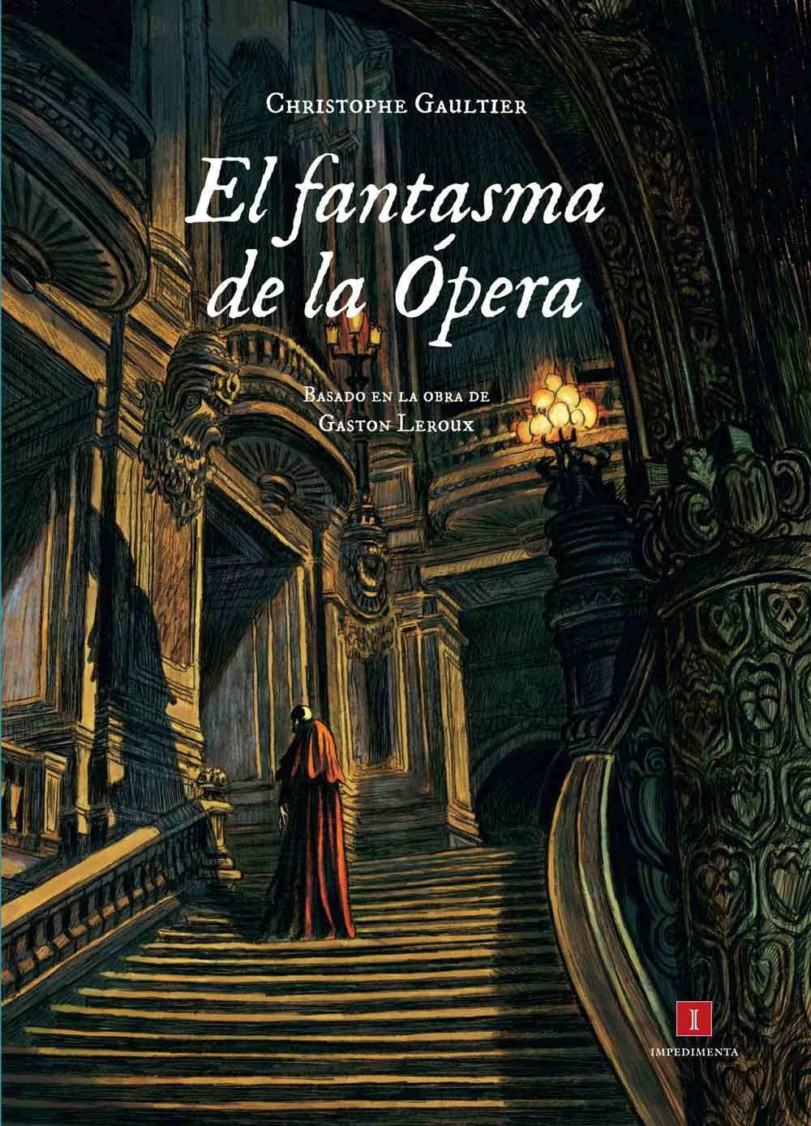

Collaborative Filtering
Recommended for you:
Other Classics:

Slide 17

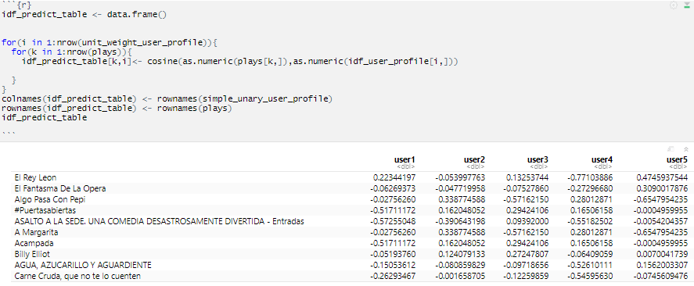



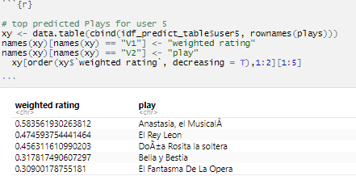
Building User Profile
People who liked Doña Rosita also liked:
Other Classics:

Slide 18
Evaluation Methods
Evaluating predictions (MAE, MSE, RMSE) using Error ratings average
Evaluating Ranking - Mean Reciprocal Rank (MRR)
Evaluating Ranking - Spearman Rank Correlation (SPR)
Evaluating Ranking - Discounted Cumulative Gain (DCG)

Slide 19
Knowledge Base: How to get data?
We get the information from theaters with whom we work with
Programming, plays’ plot, actors, actresses, directors…
Theaters keep us informed of price offers, last run time of plays, etc. in case we need to create temporary offers.
Professional critics (specialized magazines, newspapers)
OUR OWN DATABASE

Slide 20
TUATRO:
User Interface
Group A
Recommendation Engines Final Project

Slide 21
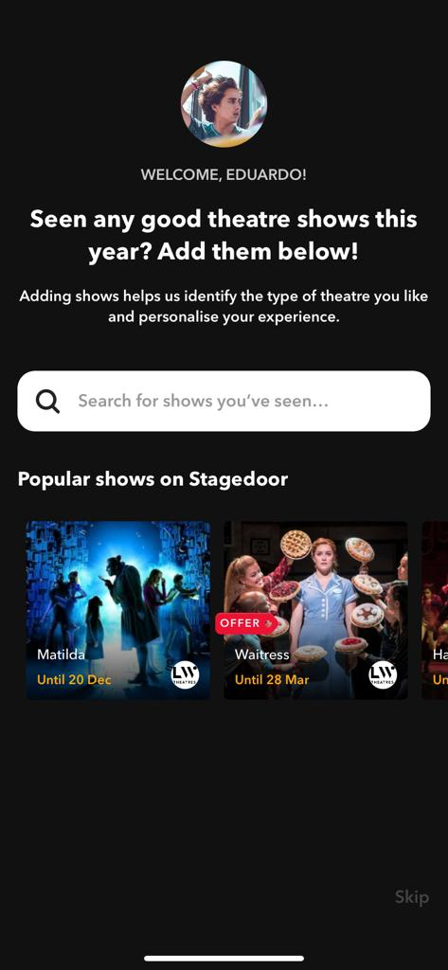
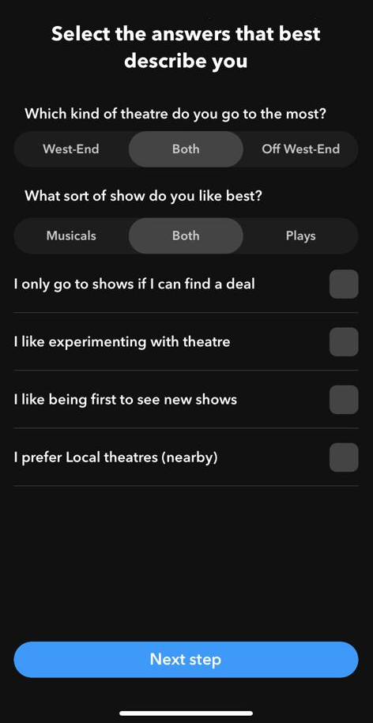
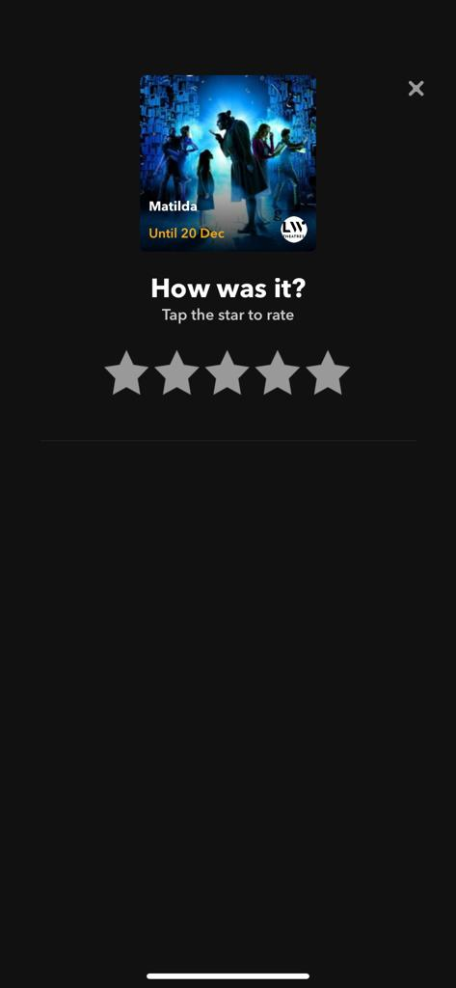

Slide 22
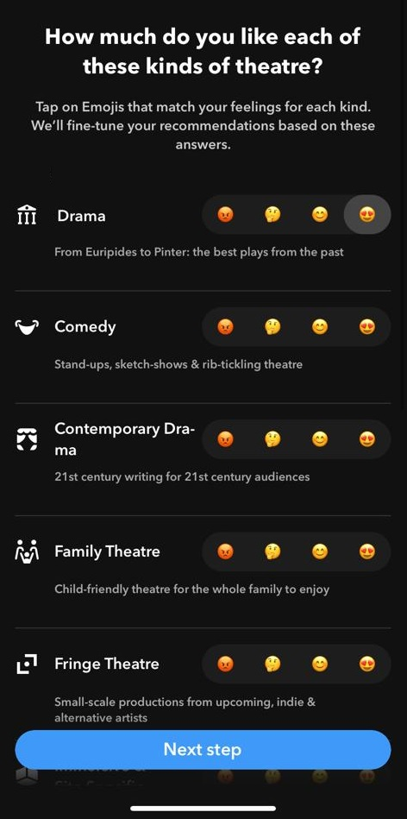
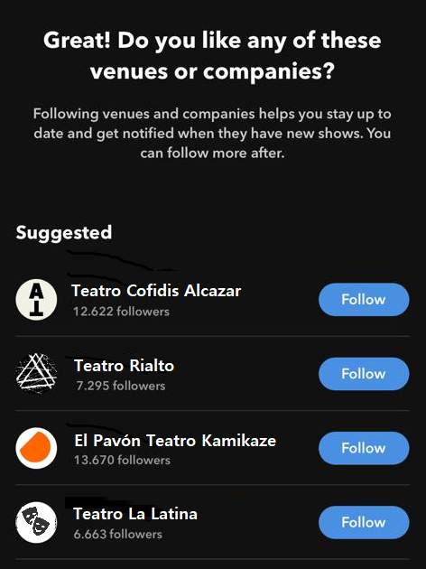
Classic (Drama), Comedy, (Contemporary) Drama, Family, Fringe, Stand-up, Politics, Dark, Musical
Teatro Alcázar, Teatro Rialto, Teatro Kamikaze, Teatro La Latina, Teatro Lara, Teatro Maravillas, Teatro Lope de Vega, Teatro Calderón, Teatro Galileo

